Slide 1
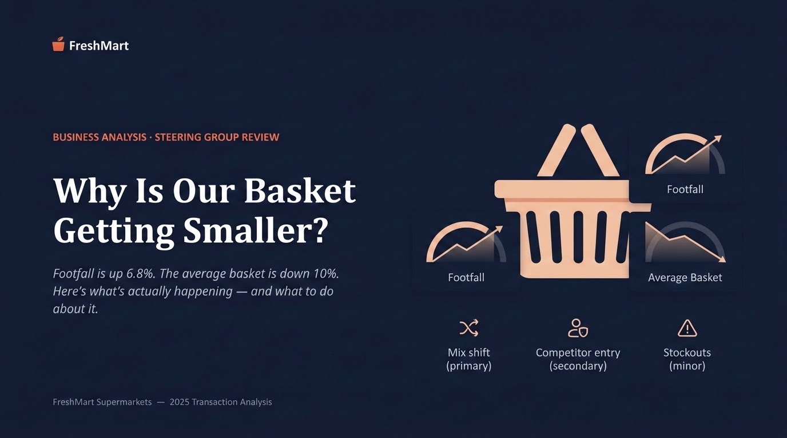

Slide 2
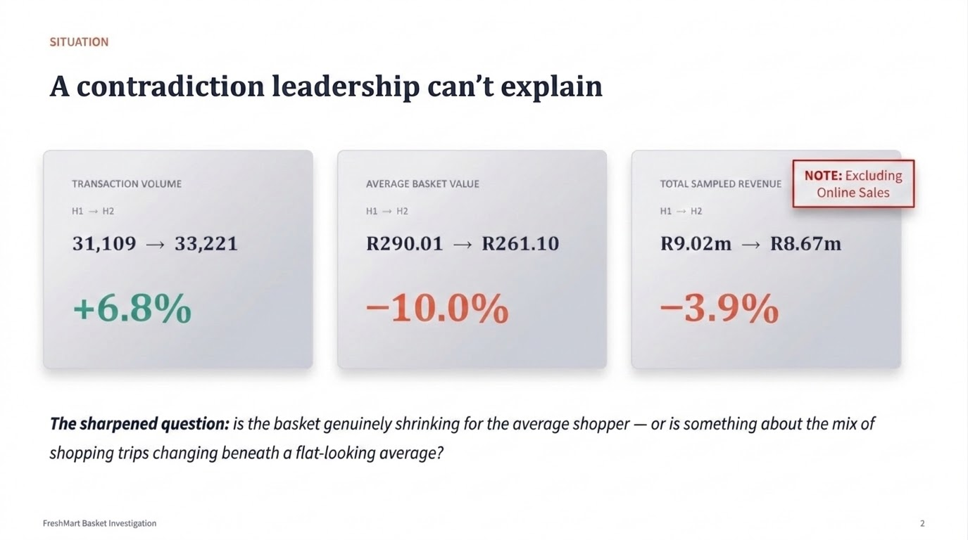

Slide 3
HEADLINE FINDING
It's not that customers are buying less.
It's that trips have changed shape.
1
2
3
Mix shift (primary)
Competitor entry (secondary)
Stockouts (minor)
Small top-up trips grew from 38% to 46% of all baskets; large stock-up trips fell from 40% to 34%. Spend inside each trip type barely moved.
The 12 stores that gained a nearby discount competitor lost ~17% more basket value than matched stores over the same window.
Baskets are ~16% smaller on stockout-affected days — real, but limited to 6 stores and one category.
FreshMart Basket Investigation
3

Slide 4
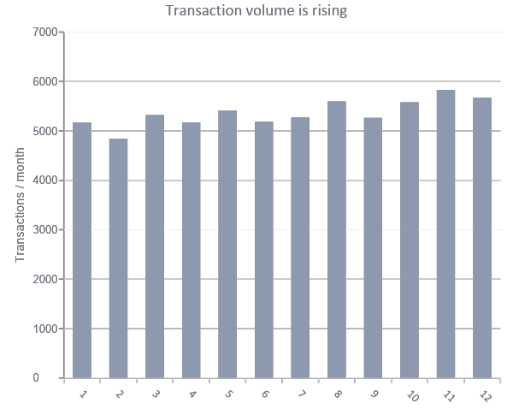
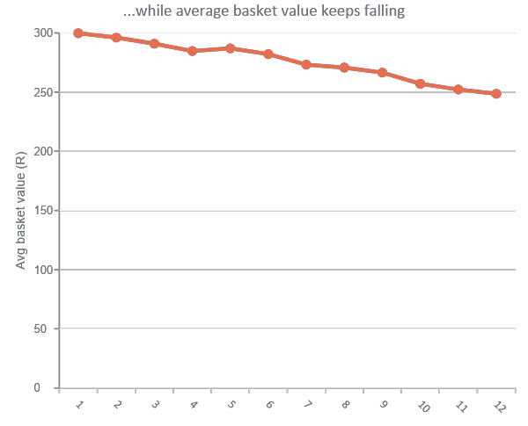
EVIDENCE 1 OF 4
The decline is gradual, not a single shock
No single month explains the shift — this points to a structural change in shopping patterns, not a one-off event.
FreshMart Basket Investigation
4

Slide 5
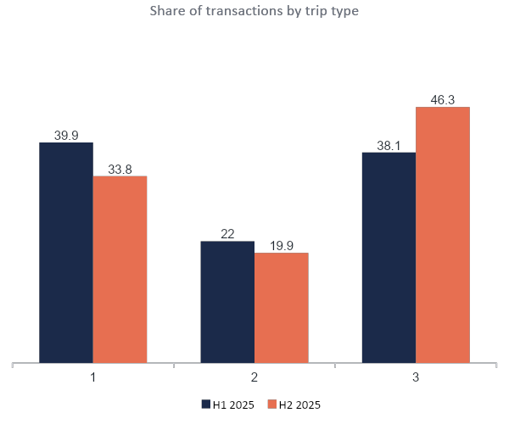
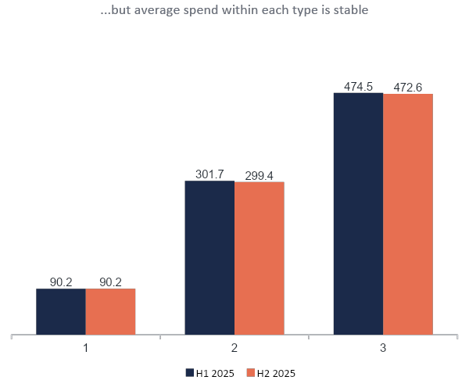
EVIDENCE 2 OF 4
Small top-up trips are replacing large stock-up trips
FreshMart Basket Investigation
5

Slide 6
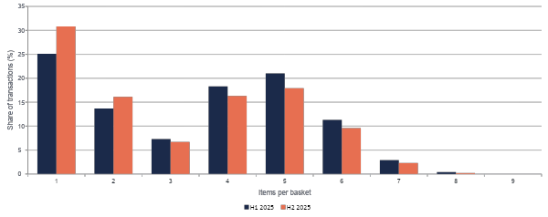
EVIDENCE 3 OF 4
Two humps, not one bell curve shifting left
If everyone were simply buying a bit less, the whole curve would shift left. Instead the top-up peak grows and the stock-up peak shrinks — the population of trips is changing, not individual behaviour.
FreshMart Basket Investigation
6

Slide 7
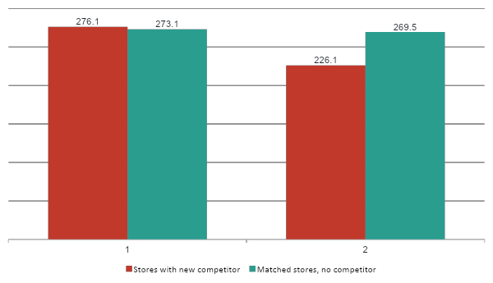
EVIDENCE 4 OF 4
Competitor entry costs ~17% beyond the seasonal trend
DIFFERENCE-IN-
DIFFERENCES EFFECT
-16.8%
Consistent across all 12 affected stores individually — not driven by one outlier.
FreshMart Basket Investigation
7

Slide 8
WHAT WE RULED OUT
Six hypotheses tested — two explain almost everything
Mix shift toward small trips
Supported — primary driver
Competitor entry near specific stores
Supported — secondary driver
Stockouts / availability gaps
Supported — minor, narrow
Uniform “customers buying less” behaviour
Rejected
Store format or province
Rejected
Day of week / payment method
Rejected (red herrings)
FreshMart Basket Investigation
8

Slide 9
RECOMMENDATIONS · 2 OF 2
Defend the stores under direct competitive pressure
3
4
Targeted competitive response at the 12 affected stores
Fix the Household Cleaning replenishment gap
Local price-matching on key value items, geo-targeted promotions, and loyalty offers timed to each competitor's opening.
Review supplier lead times and safety stock at the 6 stockout-affected stores — a quick, low-cost operational fix.
Owner: Pricing Manager + Store Managers
Impact: Medium, concentrated
Effort: Medium
Owner: Regional Ops Manager
Impact: Low chain-wide
Effort: Low
FreshMart Basket Investigation
10

Slide 10
MEASURING SUCCESS
A fair test, and a dashboard that won't be fooled again
HOW WE'LL TEST IT
MONTHLY DASHBOARD TRACKS
Pilot basket-building offers in 8–10 stores spanning all formats and provinces, with a matched control group receiving no offer — the same before/after, treatment-vs-control design already validated on the competitor analysis.
Reuse the 12 competitor-affected stores as the treatment group for the competitive response, with the 30 unaffected stores as controls.
Trip-type mix % (Small / Medium / Large) — not just the blended average
Average basket value within each trip-type band
Basket value at the 12 competitor-affected stores vs controls
Open stockout incidents by category and store
FreshMart Basket Investigation
11

Slide 11
THE ASK
Approve the pilot, defend the 12 stores, close the data gaps
1. Sign off the 8–10 store basket-building pilot, with controls, starting next month
2. Approve a targeted pricing/promotion response for the 12 competitor-affected stores
3. Commission a follow-up data request: pricing/promotion history and online/delivery order data, to close the two open questions in this analysis
Next step: pilot design and store selection, ready for sign-off within two weeks.
FreshMart Basket Investigation
12

